Slide 1


E-PROJECT prestige SCHOOL
Batch:
2410G2

Slide 2
E-PROJECT
FACULTY NAME: SIR FARHAN ALI SHAH
CO-ORDINATOR NAME: MUZNA SALEEM
BATCH CODE: 2410G2
TEAM MEMBERS: MUHAMMAD YOUSUF
BILAL SALEEM
RAHAT AZEEM

Slide 3
Problem Statement
Finding a school as per everyone’s choice is now a days is very essential and confusing as there are many schools in and around the city. Visiting each and every school physically and getting information is really very difficult. Hence concept of developing “SchoolsInfo” seems very much needed. SchoolsInfo is a website which provides the information about the various schools available in the city. People who are interested in seeking admission for their kids can view this website where they can get to know where all the schools are situated and what all other facilities are available in that particular school.

Slide 4
INTRODUCTION
"Welcome to Prestige School! We are dedicated to providing quality education in a nurturing and supportive environment. Our aim is to help every student grow, learn, and achieve their full potential. Join us on this exciting journey of learning and success!"

Slide 5
PRESTIGE SCHOOL
Welcome to [Prestige School], where excellence in education meets a nurturing environment. Established in [2006], we have been proudly serving our community for over past [19] years.
Our dedicated faculty and staff work tirelessly to provide a comprehensive educational experience that fosters academic achievement, personal growth, and social responsibility.

Slide 6
OUR Mission
To inspire and empower students to reach their full potential through innovative teaching methods and a supportive learning environment.

Slide 7
VALUABLE INFORMATION
"At Prestige School, we believe in sharing valuable information that helps our students grow and succeed. We provide clear guidance, important resources, and support to help students make the best choices for their education and future. Our goal is to ensure every student has the tools they need to achieve their dreams."

Slide 8
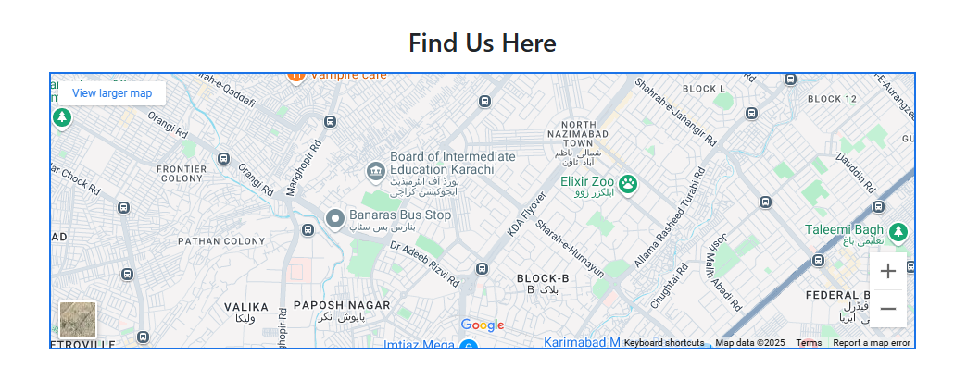
OUR LOCATION

Slide 9
OUR VISION
To create a community of lifelong learners who contribute positively to society and embrace diversity.

Slide 10


